Slide 1

Anomaly Detection & Feature Importance of School Accreditation
William SUSANTO
GA – DSI_09

Slide 2
AGENDA
Context & Problem Statement
Dataset
Problem Solving
Result
Conclusion & Recommendation
Q & A

Slide 3
Context & Problem Statement

Slide 4
Context & Problem Statement
Context
“Quality education, shaping national identity” – anonymous
Problem Statement
To find high schools graded not according to the standard (anomaly detection)
To find determinant categories to improve high school accreditation (school grade)

Slide 5
Dataset

Slide 6


Dataset
High school accreditation score (2015 – 2018)
> 11.5k schools in 34 provinces (public & private)
129 features – 8 categories
(content, process, competency, educator, infrastructure, management, budget, evaluation)
Acc. Score = sum of all 129 features score (scaled)
(range: 0 – 100)
National exam score (year 2015 – 2018)
> 14.7k schools in 34 provinces (public & private)
Exam score range: 0 - 100

Slide 7
Problem Solving

Slide 8
Problem Solving
Step 1 - Data Cleaning
Blank cells, white spaces
Duplicate data points
Null values
Step 2 - Anomaly Detection
PCA
Anomaly detection – Isolation Forest
Anomaly feature importance – Random Forest
Step 3 – School grade determinant category
Kmeans
Introduce National Exam data to measure school quality
Linear Regression, Random Forest Regression

Slide 9
Result

Slide 10
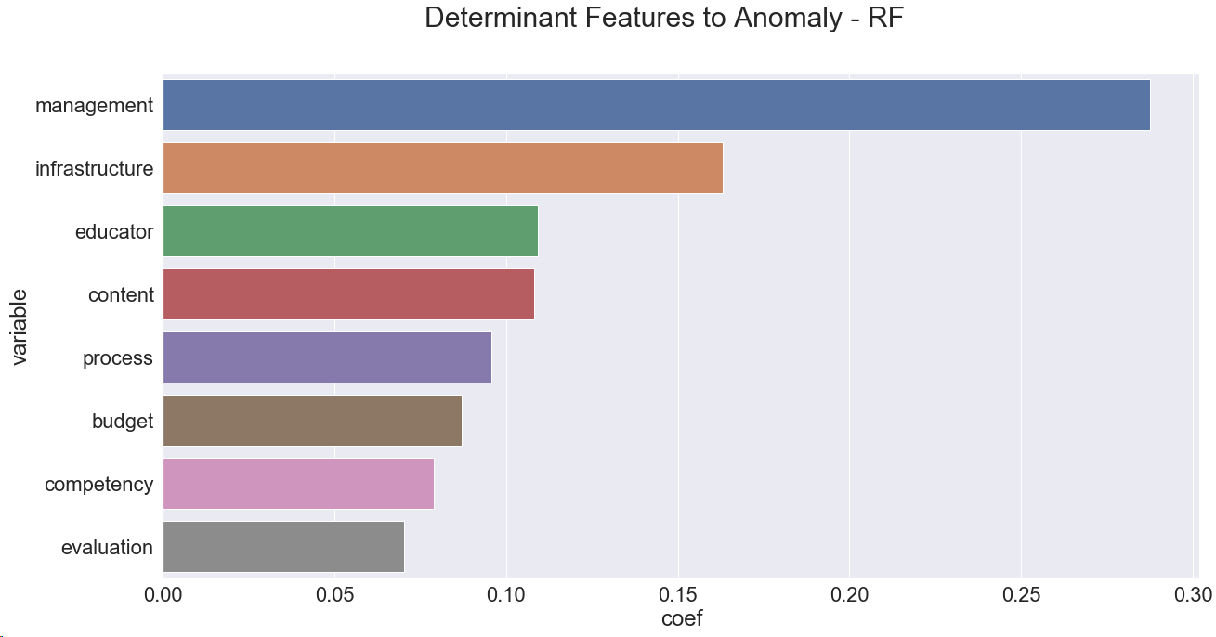
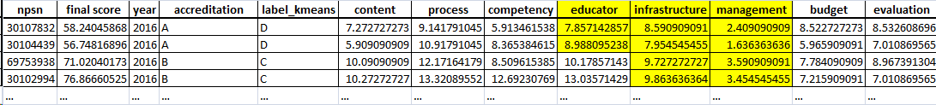
Result (Anomaly Detection)
Educator max score: 15
Infrastructure max score: 14
Management max score: 10

Slide 11
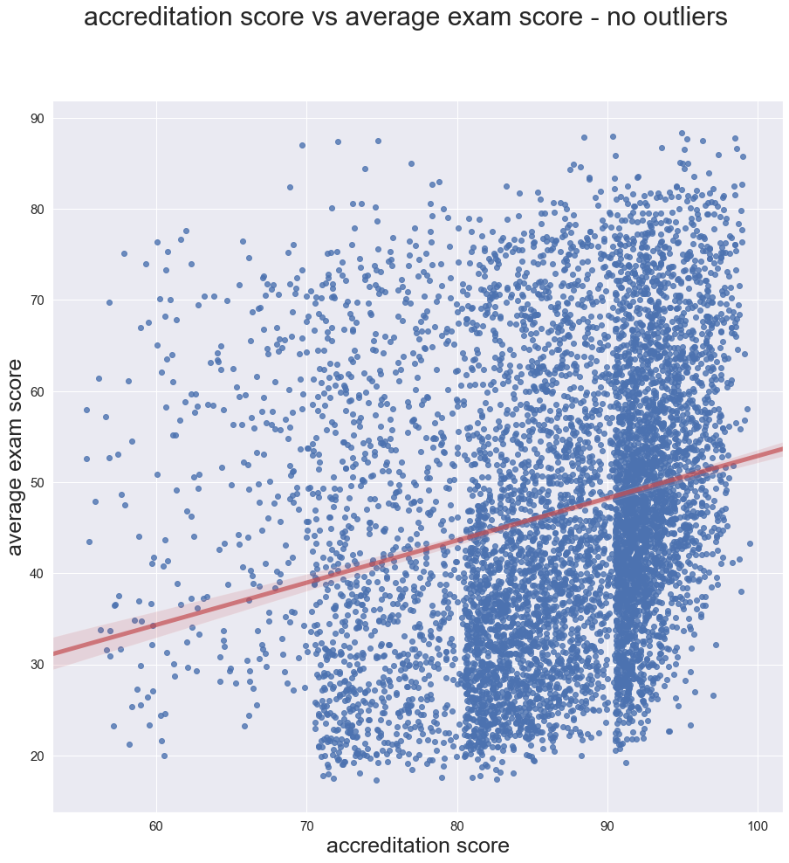
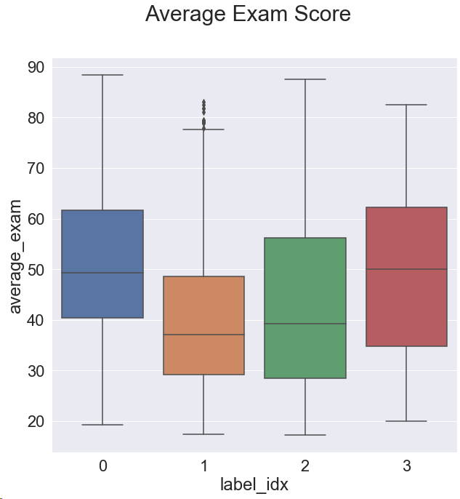
Result (School Grade)
Accreditation Score (School Grade) + Exam Score
A
B
C
D

Slide 12
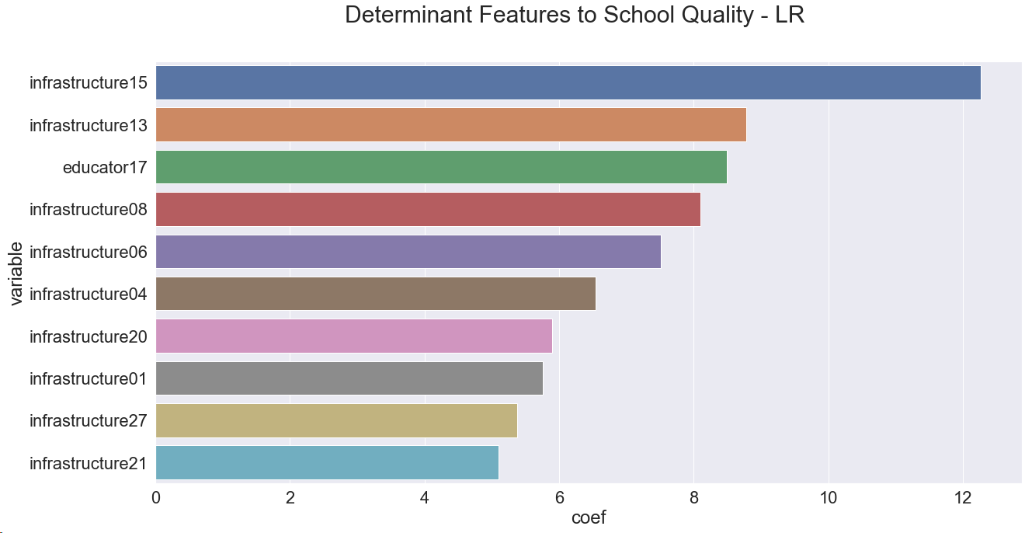
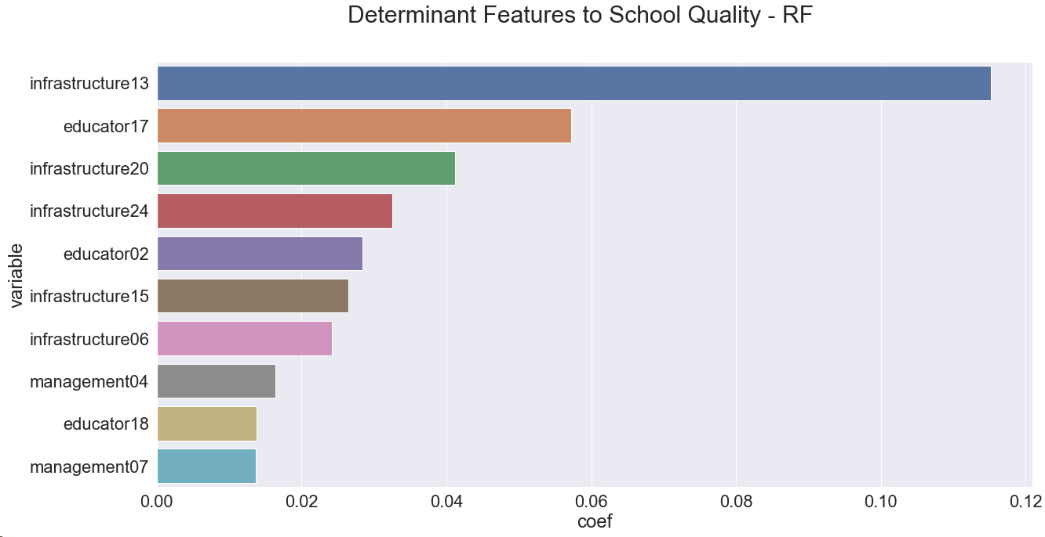
Result (School Grade)
High School Quality Determinant – Linear Regression
High School Quality Determinant – Random Forest

Slide 13
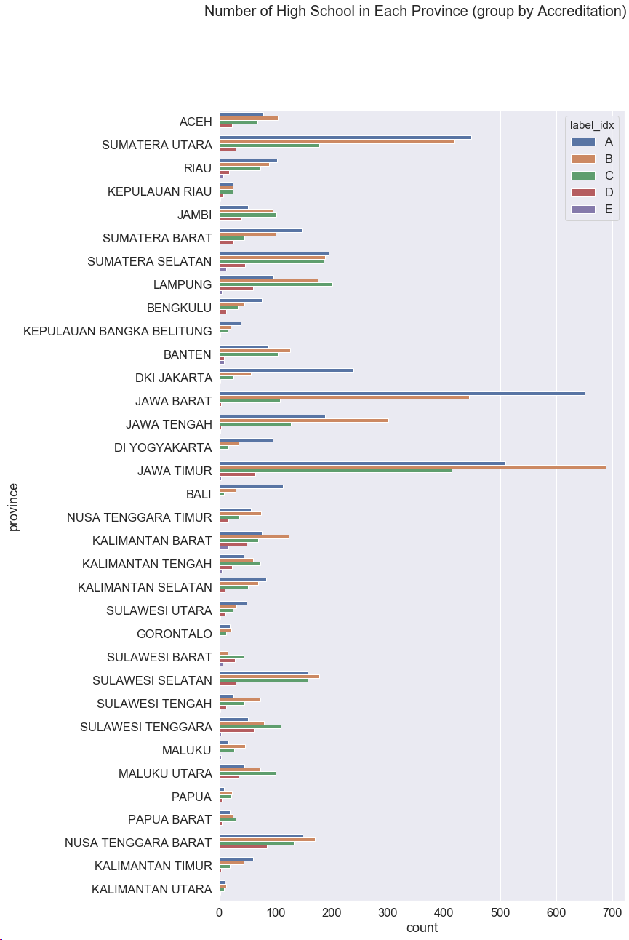
Result (School Grade)
Which Province should get more education attention?

Slide 14
Conclusion & Recommendation

Slide 15
Conclusion & Recommendation
Re-evaluate anomalous schools accreditation
Re-visit & audit the school without pre-notification.
Invent on infrastructure & educator categories:
Build laboratory, library…
Teacher wellness (salary), send teachers for training, higher degree courses.
Focus at three provinces: East Java, Lampung, & South Sumatera.

Slide 16
Q & A

Slide 19
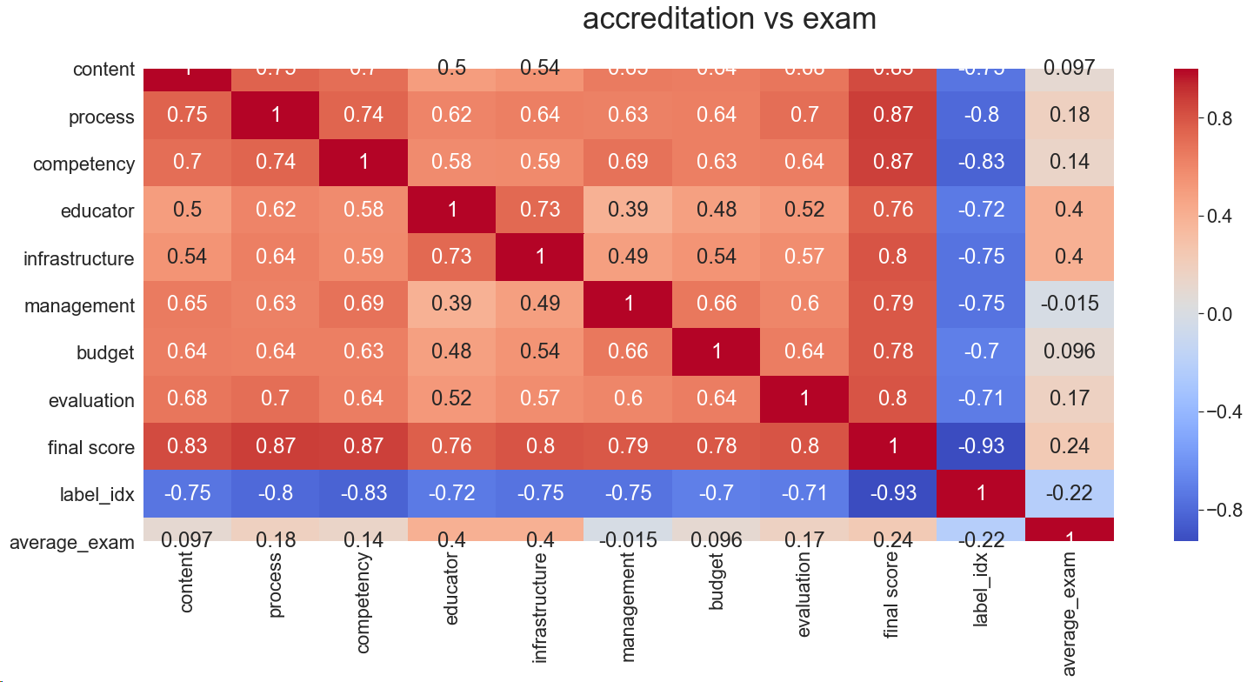
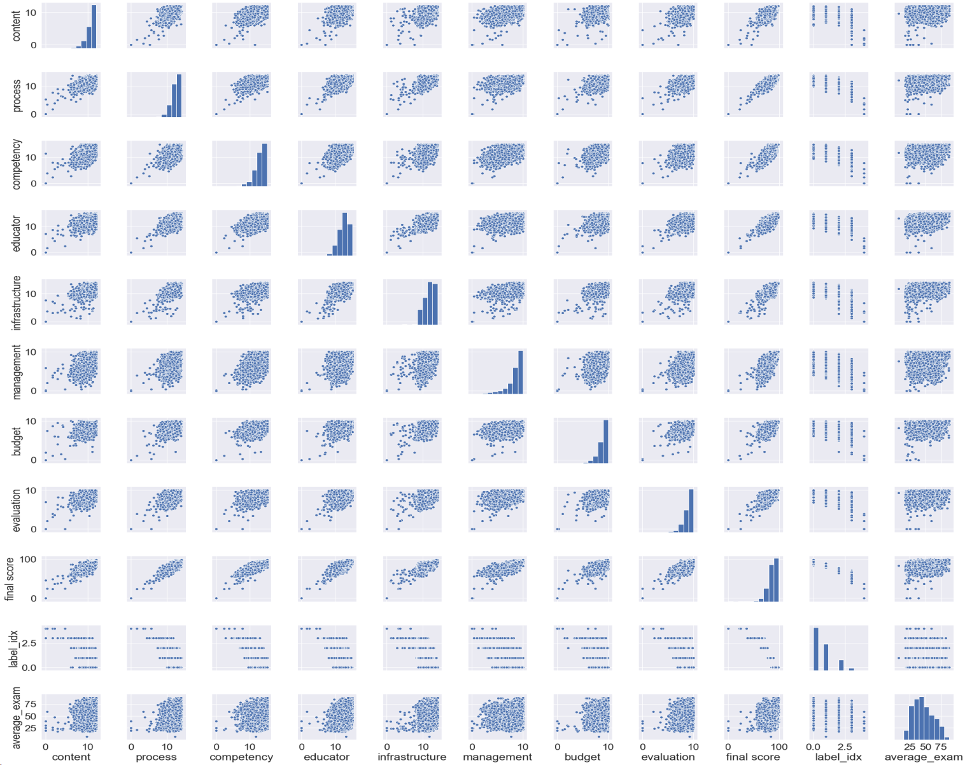
EDA

Slide 20
Conclusion & Recommendation
Conclusions
Anomaly detection with Isolation Forest approach detected anomalies.
Contributing features to anomaly are: management, infrastructure & educator. (these features dominantly contribute to decision of classifying a data point as anomaly or not)
Kmeans classification suggest 5 classification for accreditation data.
Intuitively, we would think students from good quality high school will score better at national exam. However, descriptive statistics, ANOVA test & Kruskal-Wallis test suggest there is no strong evidence that student from good high school will score better at national exam.
Investment into infrastructure & educator categories will improve school accreditation score.

Slide 21
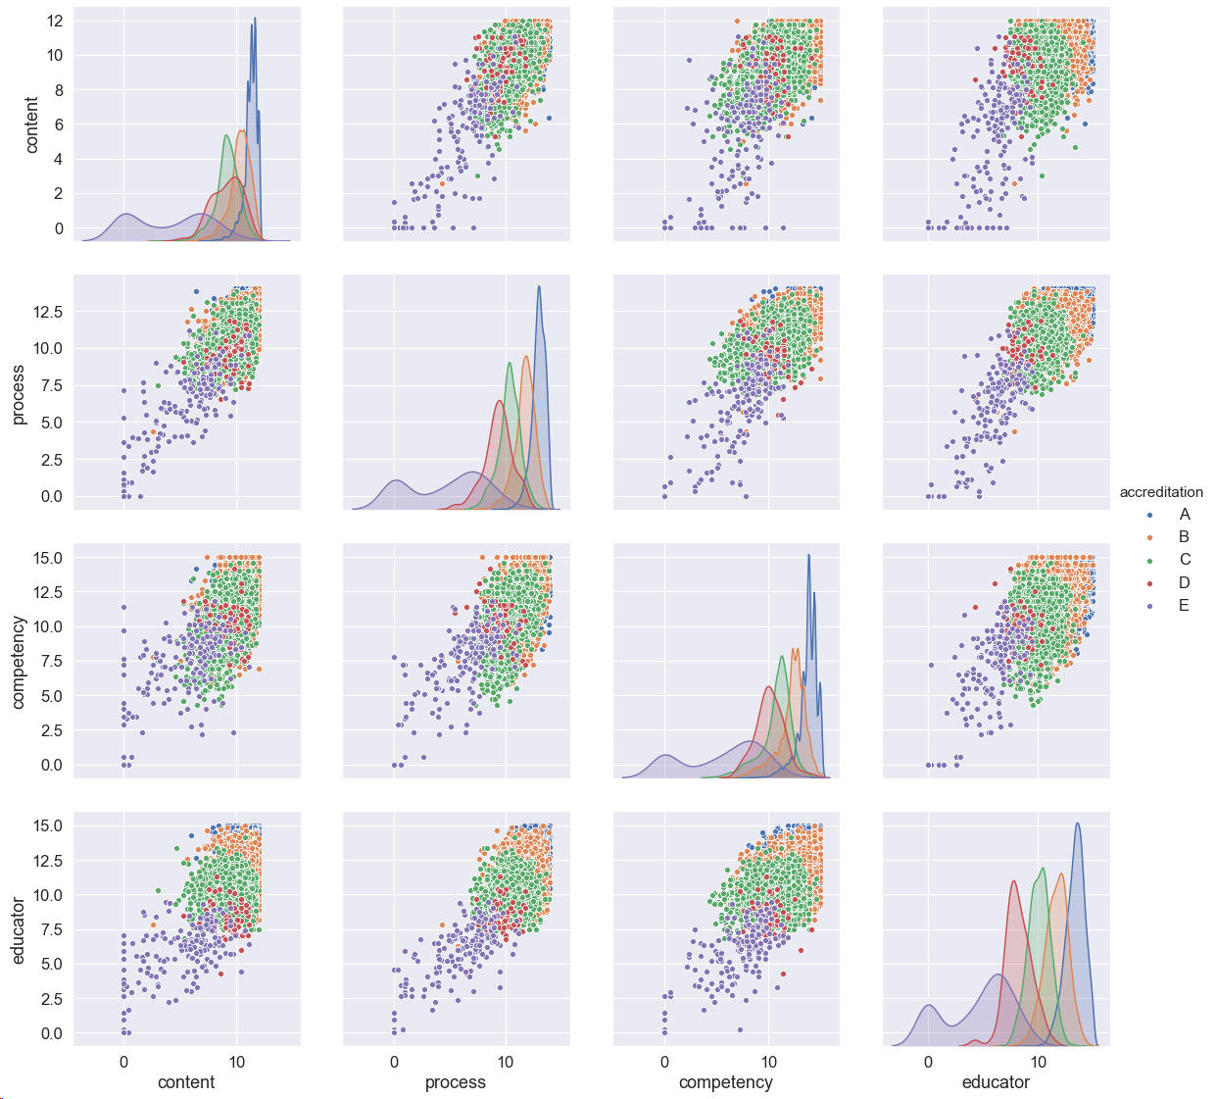
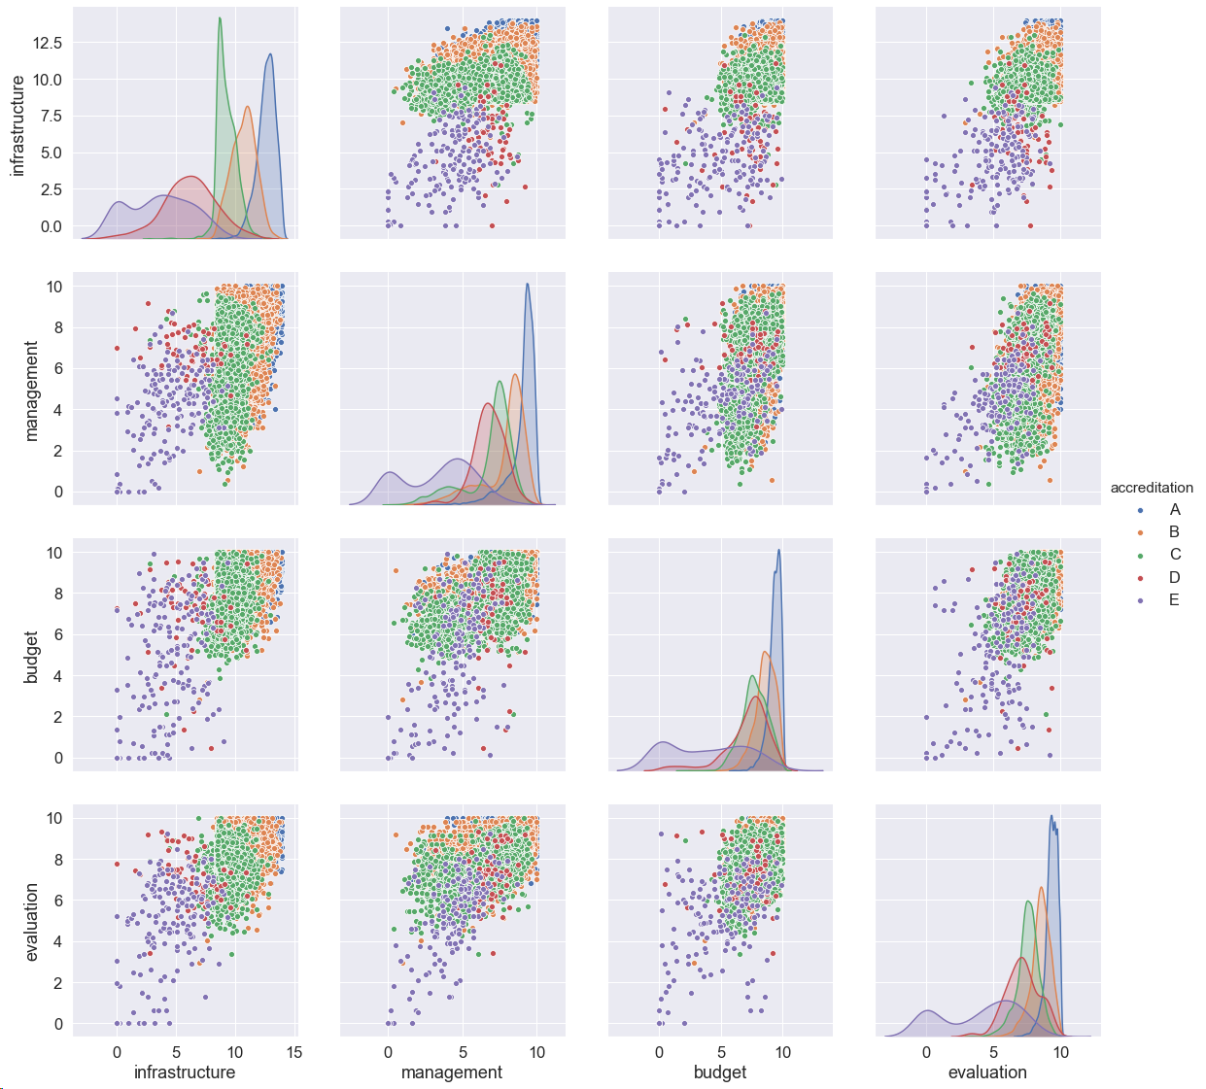
Pair plot 8 quality categories

Slide 22
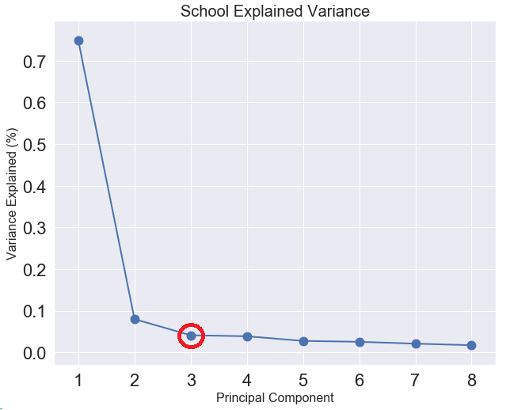
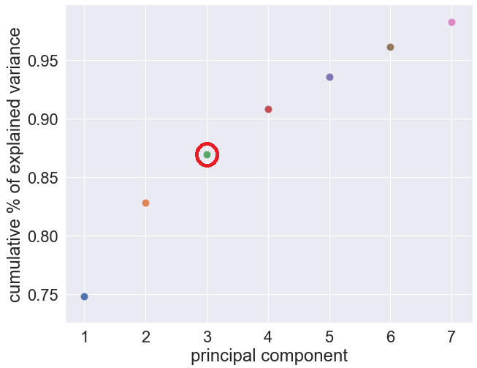
PCA-3

Slide 23
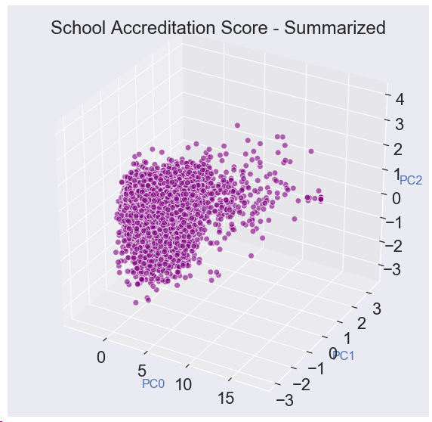
PCA-3
no | School Code | average_exam score | year
1 | 20219271 | 75.375 | 2015
2 | 20219254 | 82.81833 | 2015
3 | 20219327 | 82.92667 | 2015
4 | 20219312 | 76.30667 | 2015
5 | 20219309 | 76.34333 | 2015
6 | 20219306 | 70.72667 | 2015
7 | 20219316 | 75.17 | 2015
8 | 20219326 | 78.68167 | 2015
9 | 20219324 | 73.86667 | 2015
… | … | … | …

Slide 24
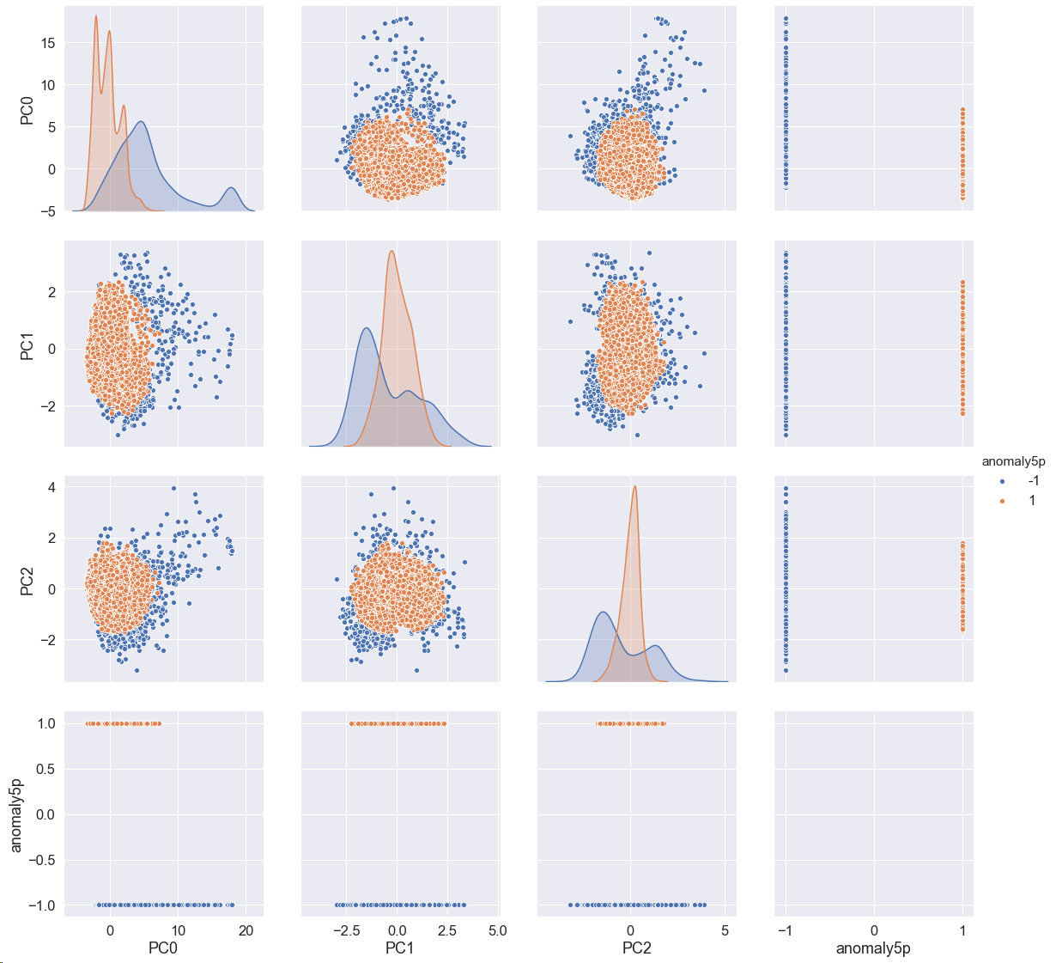
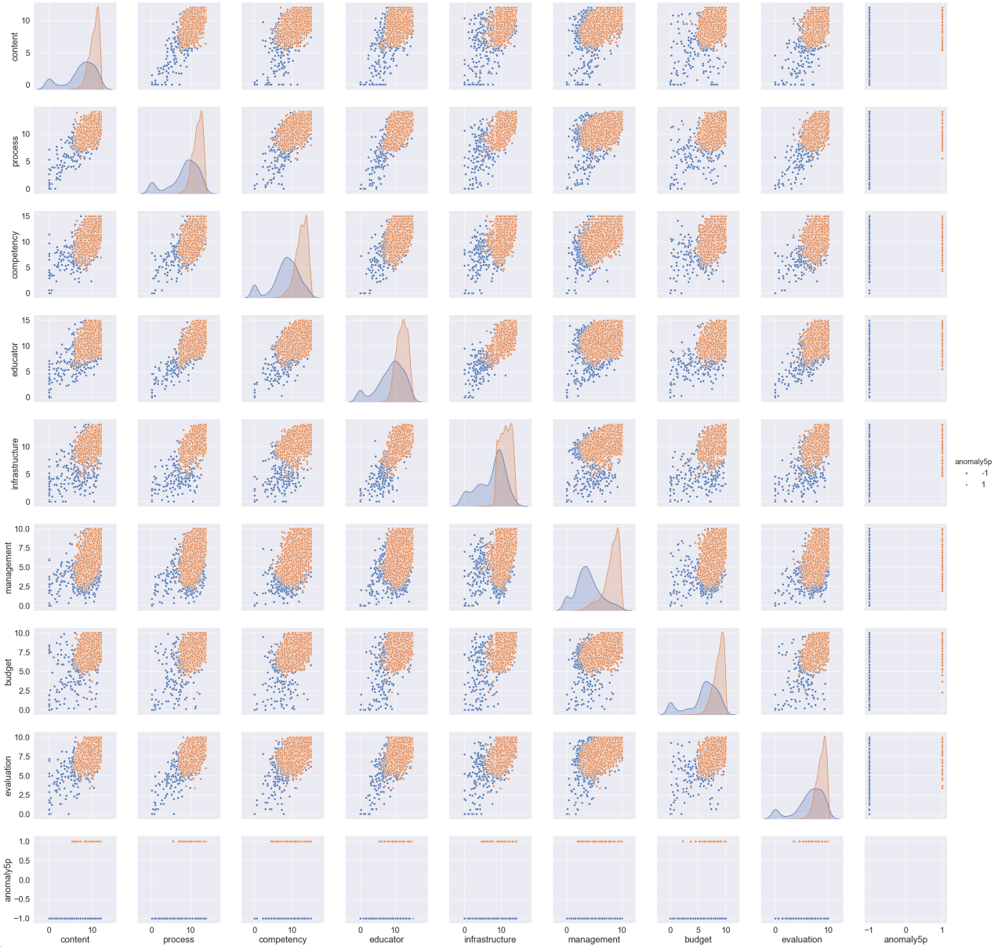
Anomaly – PCA & Categories

Slide 25
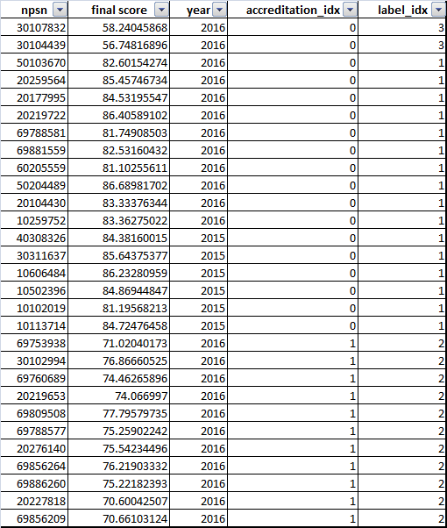
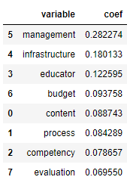
Anomaly & Feature Importance

Slide 26
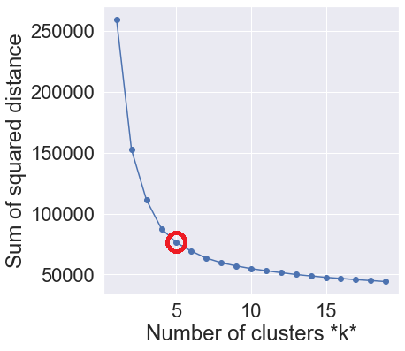
Kmeans Classification

Slide 27
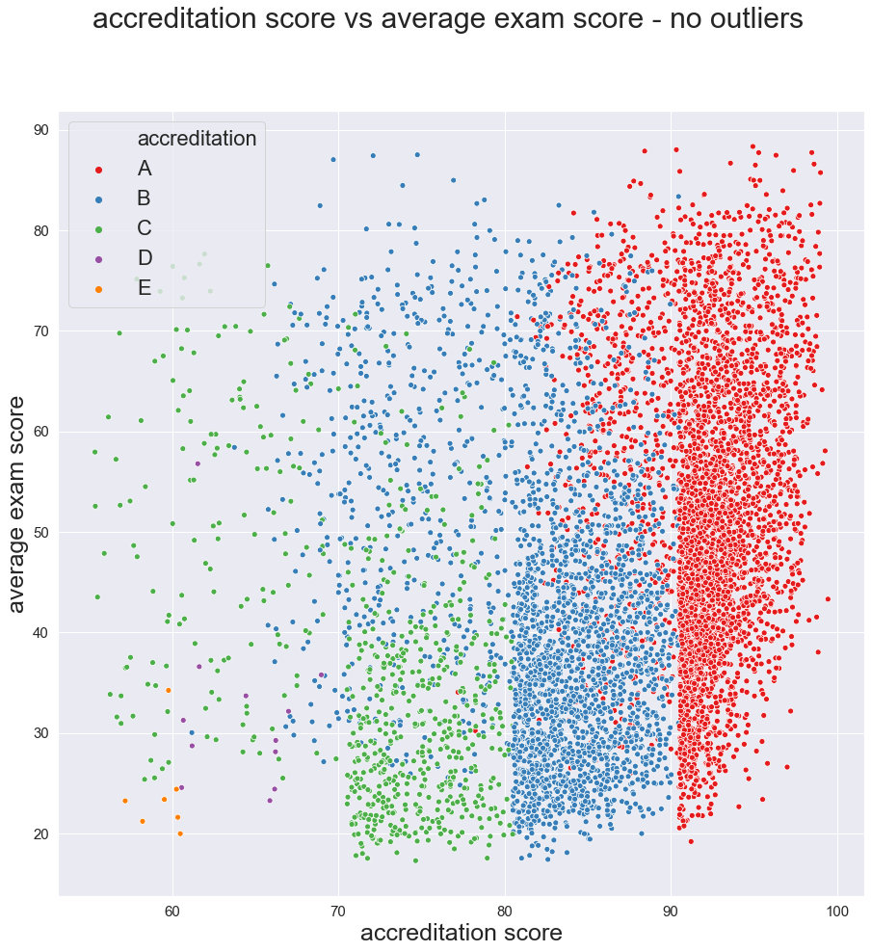
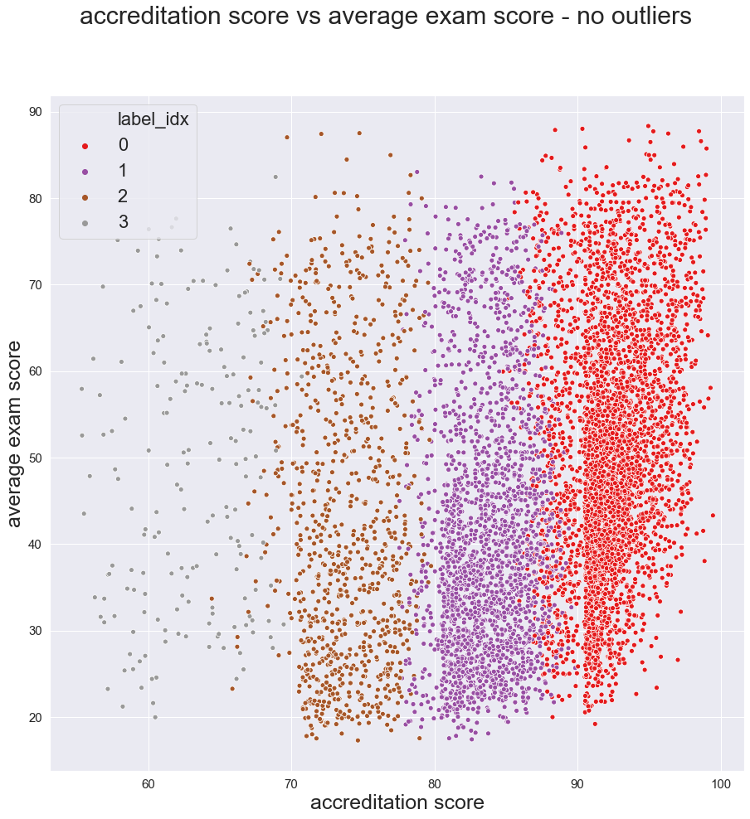
Accreditation vs Exam Score

Slide 28
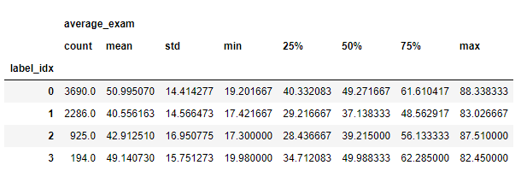
Accreditation vs Exam Score

Slide 29
Background, Scope & Problem Statement
Problem Statements
To find high schools graded not according to the standard
Classify high schools
Grouping high schools based on accreditation score
Connection between good high school & national exam result
Using national exam as a quality measurement
To find determinant categories to improve high school quality

Slide 30
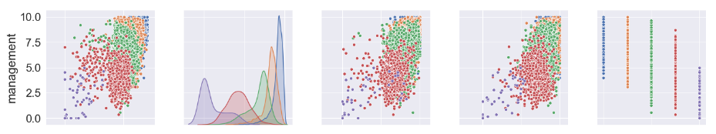
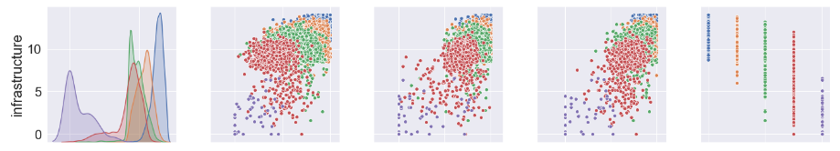
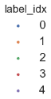
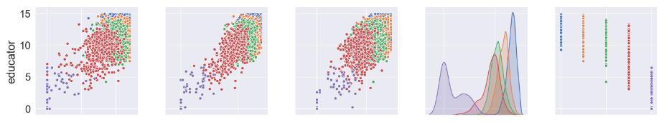
Anomaly & Feature Importance – don’t show (will raise questions)

Slide 31

Anomaly & Feature Importance – don’t show (will raise questions)

